Slide 1

Analysis of Walmart Stores Sales Using MySQL Techniques
Prepared By-
Adarsh

Slide 2
Introduction:
This project focuses on analyzing Walmart’s sales data to understand customer behavior, sales performance, and business trends. The dataset provided contains detailed transaction data, including customer demographics, product lines, sales figures, and payment methods.
This project uses advanced SQL techniques to uncover actionable insights into sales performance, customer behavior, and operational efficiencies

Slide 3
Business Problem
Objectives
Walmart wants to understand its sales performance better so it can improve customer satisfaction, increase revenue, and optimize store operations.
To achieve this, advanced MySQL queries will be employed to answer challenging business questions related to sales performance, customer segmentation, and product trends.
The objective of this project is to analyze Walmart’s sales data using SQL to uncover key insights about sales trends, customer behavior, product performance, and overall business growth.

Slide 4
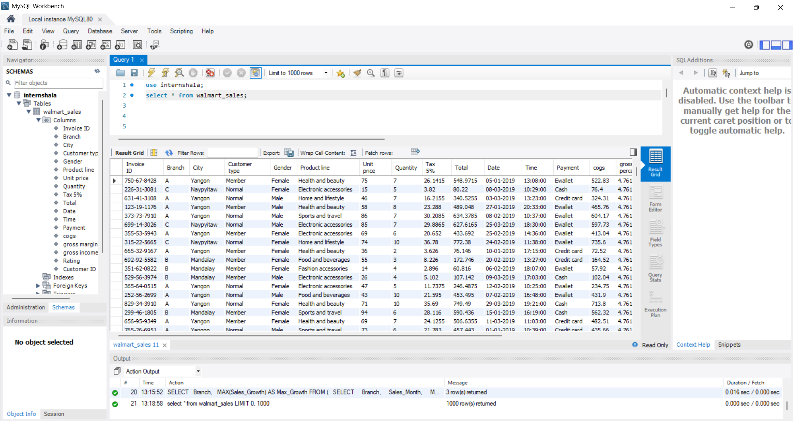
WALMART DATASET
CODE:
select * from walmart_sales;

Slide 5
Task 1: Identifying the Top Branch by Sales Growth Rate
CODE :
# monthly total sales per branch
SELECT Branch,
DATE_FORMAT(STR_TO_DATE(Date, '%d-%m-%Y'), '%Y-%m') AS Sales_Month,
ROUND(SUM(Total), 2) AS Total_Sales,
COUNT(*) AS Total_Monthly_Transactions
FROM walmart_sales
GROUP BY Branch, sales_month
ORDER BY Branch, sales_month

Slide 6
CODE :
# month over month growth
SELECT Branch, Sales_Month, Monthly_Sales,
IFNULL(ROUND(Monthly_Sales - LAG(Monthly_Sales) OVER (PARTITION BY Branch ORDER BY Sales_Month), 2),0) AS Sales_Growth
FROM (SELECT
Branch,
DATE_FORMAT(STR_TO_DATE(Date, '%d-%m-%Y'), '%Y-%m') AS Sales_Month,
ROUND(SUM(Total), 2) AS Monthly_Sales
FROM walmart_sales
GROUP BY Branch, Sales_Month) AS Monthly_Data
ORDER BY Branch, Sales_Month;

Slide 7
CODE :
# Top performer
SELECT Branch, ROUND(MAX(Sales_Growth),2) AS Highest_Growth
FROM (SELECT Branch, Sales_Month, Monthly_Sales,
Monthly_Sales - LAG(Monthly_Sales) OVER (PARTITION BY Branch ORDER BY Sales_Month) AS Sales_Growth
FROM (SELECT
Branch,
DATE_FORMAT(STR_TO_DATE(Date, '%d-%m-%Y'), '%Y-%m') AS Sales_Month,
ROUND(SUM(Total), 2) AS Monthly_Sales
FROM `walmart_sales`
GROUP BY `Branch`, Sales_Month) AS Monthly_Data
) AS Growth_Data
GROUP BY Branch
ORDER BY Highest_Growth DESC;

Slide 8
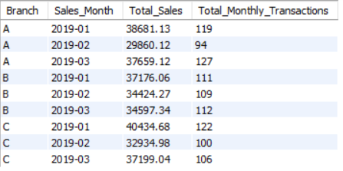
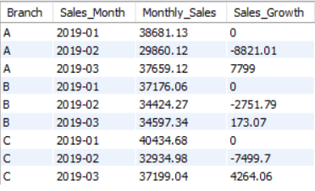

Task 1(Figures)
Fig. Monthly Total Sales Per Branch
Fig. Month Over Month Growth
Fig. Top Performer

Slide 9

Task 2: Finding the Most Profitable Product Line for Each Branch
CODE :
# Most Profitable Product Line for Each Branch
WITH prod_profit AS (SELECT Branch,`Product line`, ROUND(SUM(`gross income`), 2) AS Profit
FROM walmart_sales GROUP BY Branch, `Product line`)
SELECT Branch, `Product line`, Profit
FROM (SELECT *,ROW_NUMBER() OVER (PARTITION BY Branch ORDER BY Profit DESC) AS rnk FROM prod_profit) AS ranked_data
WHERE rnk = 1
ORDER BY Branch;
Fig. Screenshot

Slide 10
Task 2(Visual Representation)

Slide 11
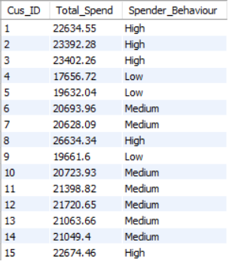
Task 3: Analyzing Customer Segmentation Based on Spending
CODE :
# Customer Segmentation Based on Spending
SELECT `Customer ID` AS Cus_ID, ROUND(SUM(Total), 2) AS Total_Spend,
CASE
WHEN ROUND(SUM(Total), 2) >= 22000 THEN 'High’
WHEN ROUND(SUM(Total), 2) >= 20000 THEN 'Medium’
ELSE 'Low’
END AS Spender_Behaviour
FROM walmart_sales
GROUP BY `Customer ID`
ORDER BY Cus_ID ASC;
Fig. Screenshot

Slide 12
Task 4: Detecting Anomalies in Sales Transactions
CODE :
# Anomalies in Sales Transactions
SELECT `Invoice ID` AS Invoice_ID, `Product line` AS Product_Line, ROUND(Total,2) AS Total,
ROUND(AVG(Total) OVER (PARTITION BY `Product line`),2) AS Avg_Sale,
CASE
WHEN Total > 1.5 * AVG(Total) OVER (PARTITION BY `Product line`) THEN 'High Anomaly'
WHEN Total < 0.5 * AVG(Total) OVER (PARTITION BY `Product line`) THEN 'Low Anomaly'
ELSE 'Normal’
END AS Anomaly_Status
FROM walmart_sales
ORDER BY `Product line`, Anomaly_Status ASC, Total DESC;

Slide 13
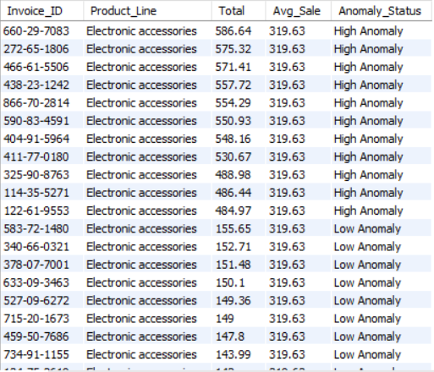
Fig. Screenshot of Task_4

Slide 14

Task 5: Most Popular Payment Method by City
CODE :
SELECT City, Payment, Payment_Count
FROM (SELECT City, Payment, COUNT(*) AS Payment_Count, ROW_NUMBER() OVER (PARTITION BY City ORDER BY COUNT(*) DESC) AS row_num
FROM walmart_sales
GROUP BY City, Payment) AS temp_row
WHERE row_num = 1
ORDER BY City;
Fig. Screenshot

Slide 15
Task 5(Visual Representation)

Slide 16
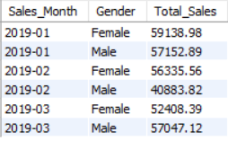
Task 6: Monthly Sales Distribution by Gender
CODE :
# Monthly Sales Distribution by Gender
SELECT DATE_FORMAT(STR_TO_DATE(`Date`, '%d-%m-%Y'), '%Y-%m') AS Sales_Month,
Gender,
ROUND(SUM(Total), 2) AS Total_Sales
FROM walmart_sales
GROUP BY Sales_Month, Gender
ORDER BY Sales_Month, Gender;
Fig. Screenshot

Slide 17
Task 6(Visual Representation)

Slide 18
Task 7: Best Product Line by Customer Type
CODE :
# Best Product Line by Customer Type
WITH product_totals AS (SELECT `Customer type`, `Product line`, ROUND(SUM(Total), 2) AS Total_Spent
FROM walmart_sales
GROUP BY `Customer type`, `Product line`),
prdt_preference AS (SELECT *, RANK() OVER (PARTITION BY `Customer type` ORDER BY Total_Spent DESC) AS rnk
FROM product_totals)
SELECT `Customer type`, `Product line` AS Preferred_Product_Line, Total_Spent
FROM prdt_preference
WHERE rnk = 1
ORDER BY `Customer type`;

Slide 19

Task 7(Visual Representation And Screenshot)
Fig. Screenshot

Slide 20
Task 8: Identifying Repeat Customers
CODE :
# Identifying Repeat Customers
WITH cust_orders AS (SELECT `Customer ID` AS Customer_ID, STR_TO_DATE(`Date`, '%d-%m-%Y') AS Order_Date
FROM walmart_sales),
filtered_dates AS (SELECT Customer_ID, Order_Date, LAG(order_date) OVER (PARTITION BY Customer_ID ORDER BY Order_Date) AS prev_order_date
FROM cust_orders)
SELECT Customer_ID, COUNT(*) AS Repeat_Cus
FROM filtered_dates
WHERE prev_order_date IS NOT NULL AND DATEDIFF(Order_Date, prev_order_date) <= 30
GROUP BY Customer_ID
ORDER BY Repeat_Cus DESC;

Slide 21
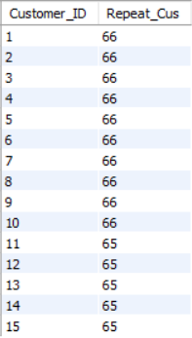
Fig. Screenshot of Task_8

Slide 22
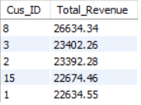
Task 9: Finding Top 5 Customers by Sales Volume
CODE :
# Top 5 Customers by Sales Volume
SELECT `Customer ID` AS Cus_ID, ROUND(SUM(`Total`), 2) AS Total_Revenue
FROM walmart_sales
GROUP BY `Customer ID`
ORDER BY Total_Revenue DESC
LIMIT 5;
Fig. Screenshot

Slide 23
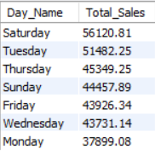
Task 10: Analyzing Sales Trends by Day of the Week
CODE :
# Sales Trends by Day of the Week
SELECT DAYNAME(STR_TO_DATE(Date, '%d-%m-%Y')) AS Day_Name,
ROUND(SUM(Total), 2) AS Total_Sales
FROM walmart_sales
GROUP BY Day_Name
ORDER BY Total_Sales DESC;
Fig. Screenshot

Slide 24
Task 10(Visual Representation)

Slide 25
KEY INSIGHTS
‘Branch A’ shows the most consistent sales growth, while ‘Branch C’ have some high sales in some months and ‘Branch B’ grows steadily slower rate.
‘Branch A’ earns more profit from “Home and Lifestyle” Product line, while ‘Branch B’ profits more from “Sports and Travel” and ‘Branch C’ makes the profit from “Food and Beverages”.
Most customers fall into the ‘Low’ and ‘Medium’ category in spending, while small group of ‘High’ spenders contribute a major share of the total revenue.
Payment preferences vary across cities. ‘E-Wallet’ is the most common used payment method overall.
Female customers consistently contribute more monthly sales compared to male customers.
A small group of customers makes repeat purchases within 30 days, indicating loyal customers. These customers will be ideal targets for loyalty programs.
‘Saturday’ has recorded the highest sales, followed by ‘Tuesday’ and ‘Thursday’. This shows strong shopping in weekend and mid-level shopping in weekdays.

Slide 26
Thank you
Project Video Link:
https://www.loom.com/share/6ae6fa92287f421791836f10e38d076f

